Slide 1

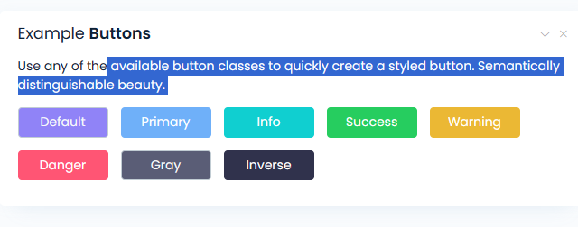


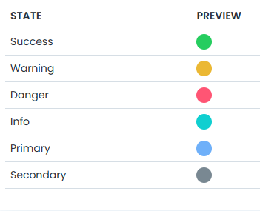

Lighting
Curtains open
action
Lighting
Lighting
Curtains closed

